Slide 1
Literature Report
Jiang 12.5. 2023

Slide 2
CORTEX

Slide 3
Impact Factor

Slide 4
Introduction
1.1. Threat-related stimuli
1.2. ERPs
1.3. Presentation duration
1.4. Aim to

Slide 5
1.1.Threat-related stimuli
Increased attention
Attentional capture
Emotional information
Distraction tasks or limited stimulus exposure--An automatic response (fearful faces)
Conflicting goal-relevant attention tasks or perceptual information--Available resources
Fearful faces
Danger
Processing advantage
N170\EPN\LPP—emotional effects

Slide 6
1.2. ERPs
N170
A structural and configural encoding component
Faces >objects
EPN
A mid-latency component
Early attentional selection—task and emotion processing(co-occur)
LPP
Stimulus evaluation and controlled attention processes
competing tasks or goals

Slide 7
Previous ERP studies
N170
Increased amplitudes for fearful expressions
Neither affected by attention task nor by load manipulations
EPN/LPP
Increased amplitudes for emotional expressions during perceptual distraction tasks
Required participants
Monitor fixation cross changes
Discriminate overlaid symbols, numbers, or the length of overlaid lines
Working -memory-related distraction tasks

Slide 8
Recent studies
EPN
Depend on attention directed to the face
Tasks
A peripheral letter identification task
Discriminate the orientation of overlaid lines (horizontal vs vertical)
Detect color changes from peripherally rotating dots
Results (absent differences between fearful and neutral faces)
Attention was directed to perceptual overlaid lines
Faces follow shortly (i.e., 100, 300, or 600 msec) after a demanding preceding perceptual load task
LPP
Depend on attention to the emotional expression (absent interactions)

Slide 9
Conclusion
Later ERP components
Increasingly dependent on attention to emotionally relevant information
Significantly increased amplitudes
EPN
Prerequisite —LPP
As a bottleneck for emotional awareness of stimuli and further selective attention processes

Slide 10
1.3. Stimulus presentation duration
Present or absent emotional EPN or LPP difference
100ms
Neither EPN nor LPP emotion effects (perceptual distraction task)
150ms
EPN but no LPP emotion effects
300~500ms
Either EPN or LPP, or even both ERPs to be increased for emotional expressions
2000ms
Relatively large emotion differences during the LPP window

Slide 11
Thus: Be relevant
Be short
Focused to the task-relevant feature to resolve the task
Exceed the time necessary
Available for the processing of emotional features
Not necessary in serial order
The heterogeneity of reported emotion effects
Switches between the task and emotion-related stimulus features
The task difficulty

Slide 12
1.4. Aim to
If the increasing duration of face presentation is the critical factor of EPN and LPP amplitude enlargements for fearful faces
Presentation durations (100\300\1000\2000 msec)
Fearful and neutral faces
Respond to thin lines displayed above the faces
Expected
Fearful -neutral differences are expected to interact with the presentation duration for the EPN and LPP

Slide 13
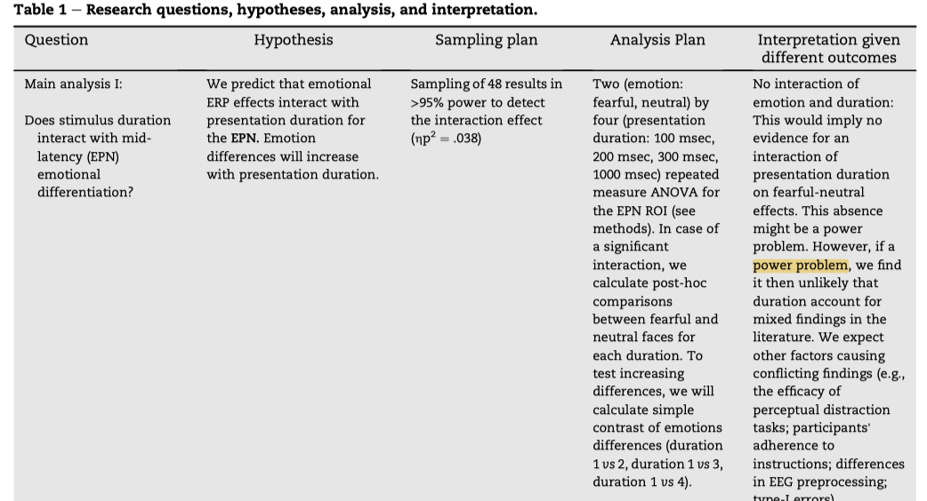
Questions, hypotheses, analyses, interpretation

Slide 14
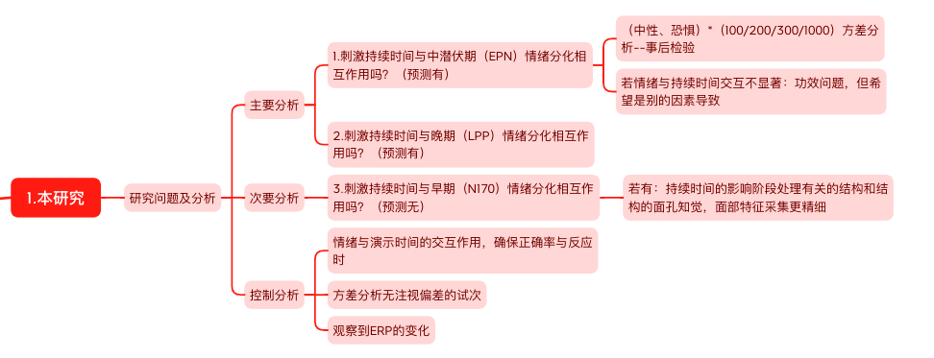
Questions, hypotheses, analyses, interpretation （Protocal）

Slide 15
Methods
2.1. Participants
2.2. Stimuli
2.3. Procedure
2.4. EEG recording and preprocessing
2.5. Eye-tracking recording
2.6. Data analyses

Slide 16
2.1. Participants
G*Power 3.1.7 -- >95% (0.038)
59-11
Exclusion criteria (EEG data):
More than two interpolated electrodes within the sensor clusters of interest for main analyses (EPN/LPP)
More than ten interpolated sensors in total
Less than 50% kept trials in a single condition
Behavioral exclusion criteria:
A mean performance lower than 80% correct responses

Slide 17
48
36 female, 11 male, 1 diverse;
18 to 34 years old (M = 23.67, SD =3.93);
Normal or corrected-to-normal vision
Right -handed
No reported history of neurological or psychiatric disorders
Informed consent
Received 10 Euros per hour

Slide 18
2.2. Stimuli
The facial stimuli from:
The Radboud Faces Database
The Jena3D face database
Greyscale photographs of 16 males and 16 females
Cropped hair, ears, and neck
Depict 64 identities: 32 male, 32 female (neutral or fearful expressions)
The SHINE toolbox
Match luminance for the face stimuli

Slide 19
Each face stimulus:
A width of 6.3 degrees of visual angle (deg)
A height of 8.3 deg
An overlay of five horizontal or vertical thin lines within the boundaries of the face
Horizontal lines 4.0 deg; vertical lines 5.2 deg; thickness .03 deg

Slide 20
2.3. Procedure
A demographic questionnaire
EEG
A Gamma-corrected display
A background displayed in medium grey (RGB 128, 128, 128)
60 Hz with a Michelson contrast of .9979 (Lmin- = .35 cd/m2 ; Lmax = 327.43 cd/m2 )
Seated 60 cm in front of the display
The lines above the stimuli (horizontal or vertical)

Slide 21
Eight different presentation orders (pseudo-randomized)
A-B-C-D
D-A-B-C
C-D-A-B
D-C-B-A
A-D-C-B
B-A-D-C
C-B-A-D

Slide 22
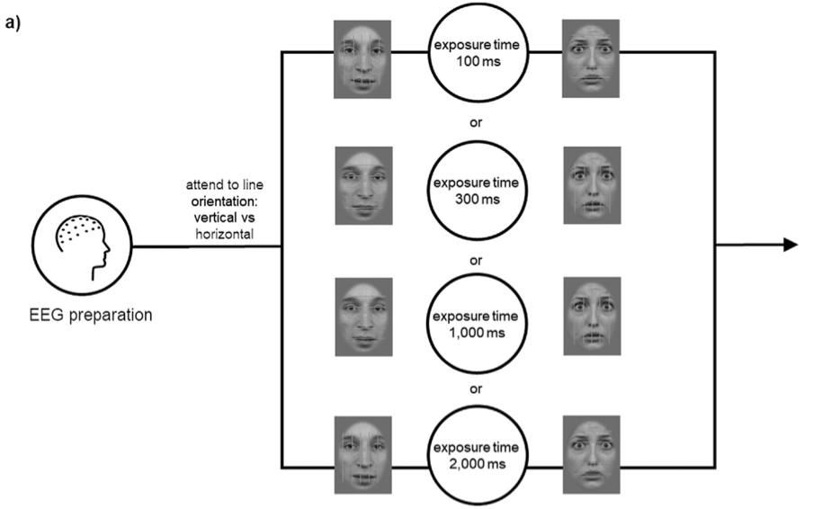
The trial structures
(fig. 1)

Slide 23
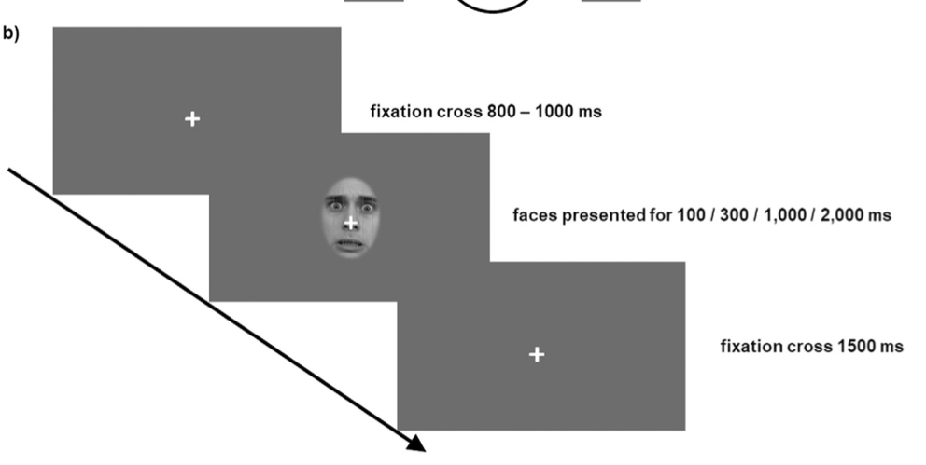
The trial structures
(fig. 1)

Slide 24
Respond:
Push either X or M for horizontal or vertical lines
Using one finger of each hand
Response keys were counterbalanced between participants.

Slide 25
Instruction
Reduce eye movements and movements
Constantly fixate the central fixation cross
Blinking on the fixation cross
Avoid blinking during stimulus presentation
Respond as quickly and accurately as possible

Slide 26
Eye-gaze position
An eye tracker
Online evaluation: abort trials whenever the gaze fell out of a 3。 radius around the fixation cross
Trials:
64 fearful, 64 neutral, 4 presentation duration
512 trials （64+64）*4
Toolbox:
Matlab (Version R2019b)
The Psychophysics Toolbox (Version 3.0.15)
The Eyelink Toolbox

Slide 27
2.4. EEG recording and preprocessing
Recording:
A sampling rate of 512 Hz from 64 BioSemi active electrodes
The Biosemi's Actiview software
Online references: two additional electrodes (CMS and DLR) ？
Offline :re-referenced to average reference

Slide 28
Preprocessing:
BESA
Eye movements and blinks were corrected (automatic eye-artifact correction method)
Three topographies accounting for EOG activities:
Horizontal and vertical eye movement and blinks (HEOG, VEOG, blink)
A principal component analysis (PCA):
correlation between data and artifact topography exceeded the HEOG (150 mV) or VEOG (250 mV) thresholds (segments)

Slide 29
Recorded data:
A linear combination of brain and artifact activities (topography)
A low-cutoff filter of .01 (6 dB/oct), a 40 Hz low-pass zero-phase filter (24 dB/oct)
An absolute threshold (>120 mV), signal gradient (>75 mV/vT), and low signal (i.e., the SD of the gradient, <.01 mV/vT)
50 percent of trials per condition had to be accepted
Noisy EEG sensors--a spline interpolation procedure
LCD screen (presentation delay 29 msec) --stimulus timing were corrected during epoch

Slide 30
Filtered data:
From 200 msec before stimulus onset until 1000 msec after stimulus presentation
A baseline correction:
Inhouse Matlab functions
Subtract the average voltage of the 200 msec before stimulus onset
Excluded trials:
stopped due to gaze deviations
incorrect responses

Slide 31
2.5. Eye-tracking recording
Track eye-gaze behavior:
The Eyelink 1000 eye-tracker from SR research
Placing heads on a chinrest, the right eye was recorded
Recording sampling rate(1000 Hz)
An eyetracker calibration procedure:
Automatically initiated using a nine-point calibration procedure

Slide 32
Gaze position:
Tracked continuously during the experiment and online evaluated
Stopping experimental presentation whenever the gaze deviated more than 3 at a radius around the fixation mark
Discarded from further analyses

Slide 33
2.6. Data analyses
2.6.1. Main analyses
2.6.2. Secondary analyses
2.6.3. Control analyses
2.6.4. Explorative analyses

Slide 34
2.6.1. Main analyses
Examined interactions of emotion and presentation duration for the EPN and LPP components
Two (emotion: fearful/neutral) by four (presentation duration: 100/300/1000/2000 msec)
Repeated measure ANOVAs
Statistical analyses for ERP and behavioral data -- JASP:
An open-source statistic software
Based on the programming languages R and C++
Allows calculations of frequentist and Bayesian statistics

Slide 35
The effect size:
Partial eta-squared and Cohen's d
Post -hoc comparisons
Between fearful and neutral faces for each duration for significant interaction effects
Using the Bonferroni-Holm correction
Simple contrasts
Differences tested the expected increase of fearful-neutral differences

Slide 36
Identified the time windows and electrodes:
Visually inspecting the collapsed ERPs of the pilot data
Previous studies using similar tasks and stimuli
Identify the EPN and LPP components:
The pilot data:
collapsed ERPs across all fearful compared to all neutral faces
EPN effects: from 200 to 350 msec; from a symmetrical occipital cluster (P9, P7, PO7, O1, P10, P8, PO8, O2)
LPP effects: from 400 to 1000 msec; from a centro-parietal cluster (CP3, CP1, CPz, CP2, CP4, P3, P1, Pz, P2, P4)
Confidence intervals: bootstrap method

Slide 37
Bootstrap： An N-by-T (time points) matrix
Randomly drawing N times with replacement
Averaged across the subject dimension
Repeated 1000 times -- a 1000-by-T matrix
The 2.5- and 97.5-percentile was calculated -- a 95% confidence interval around the mean ERP
 | 100ms |  |  | 300ms |  |  | 1000ms |  |  | 2000ms
 | EPN | LPP | N170 | EPN | LPP | N170 | EPN | LPP | N170 | EPN | LPP | N170
M1
M2
···
M1000

Slide 38
2.6.2. Secondary analyses
Emotion and presentation duration interactions for the N170 component
Identified the N170 time windows and electrodes:
Visual inspection of the collapsed ERPs across all conditions
From 120 to 170 msec
Averaged from a symmetrical occipital cluster (P9, P7, PO7, P10, P8, PO8)

Slide 39
2.6.3. Control analyses
Control variables:
The accuracy and reaction times
Considered: correct responses
Test:
Significant interactions in accuracy or reaction times between presentation duration and emotion
No significant interactions
If the average absolute activity of the HEOG and VEOG channels differs between conditions

Slide 40
2.6.4. Explorative analyses
If the late positivity can be separated by using an Independent Component Analysis (ICA) at the group level
The group ICA toolbox EEGIFT
A principal component analysis (PCA):
Reduce the data to 20 components
The top 20 components: typically explain more than 95% of the variance
ICA:
EEGIFT
Selected two components by visual inspection

Slide 41
For each of these components and for each duration:
Compared fearful and neutral conditions
Using cluster-based permutation tests using the complete post-stimulus interval
Correcting for multiple testing
Post-hoc comparisons:
For each duration for the examined ERPs and ICs

Slide 42
Results
3.1. Main ERP results
3.2. Secondary ERP results
3.3. Explorative tests
3.4. Behavioral results
3.5. Control analyses

Slide 43
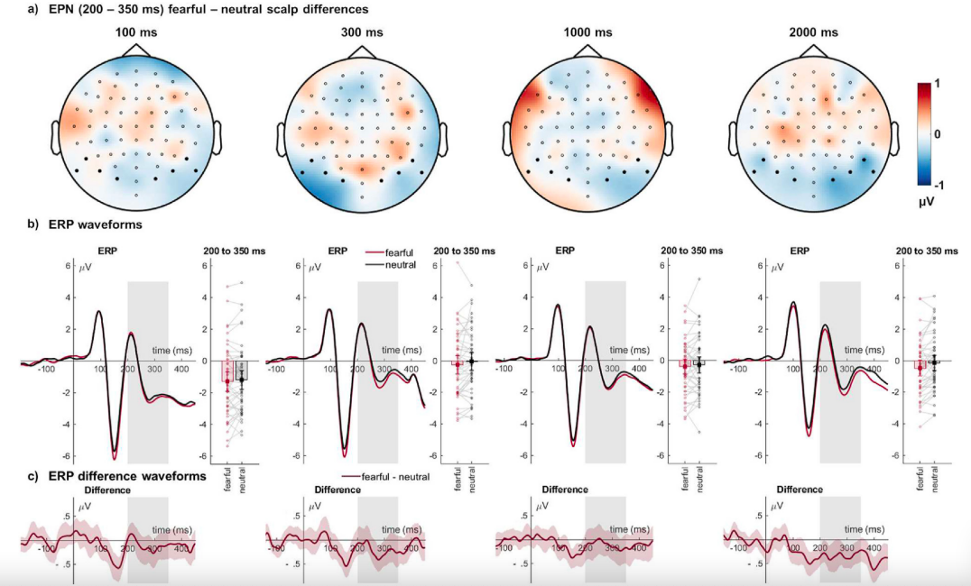
Fig.2

Slide 44
3.1. Main ERP results
EPN
A main effect of emotion: (p = .005) greater amplitudes for fearful than neutral faces(fig.2)
The interaction of emotion and presentation duration: insignificant (p = .467)
EPN effects -- exploratory tests:
Absent: the presentation durations of 100 msec (t(47) = .63, p = .534), 300 msec (t(47) = 1.36, p = .181) or 1000 msec (t(47) = .54, p = .593)
Present: the long presentation duration of 2000 msec (t(47) =2.95, p = .005)

Slide 45
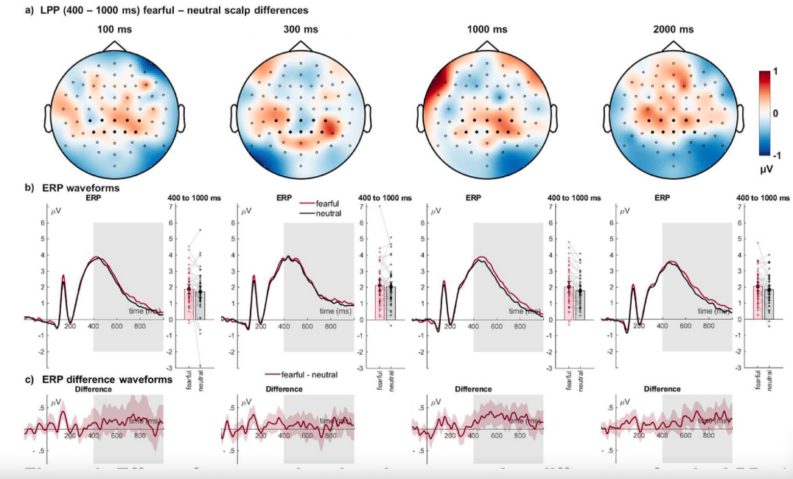
Fig.3

Slide 46
LPP
A main effect of emotion: (p = .009) fearful faces showed a higher positivity than neutral faces (fig.3)
The interaction of emotion and presentation duration: insignificant (p = .520)
LPP effects -- exploratory tests:
Absent: presentation durations of 100 msec (t(47) = .90, p = .371) and 300 msec (t(47) = .34, p = .737)
Present: the long durations of 1000 msec (t(47) = 2.49, p = .016) and 2000 msec (t(47) = 2.40, p = .022)

Slide 47
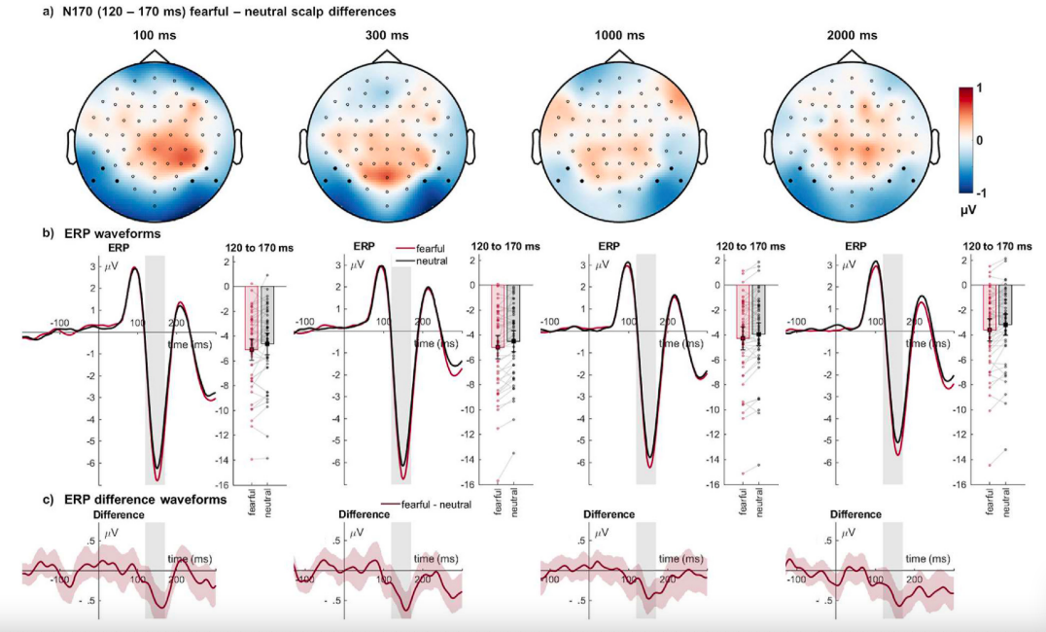
Fig.4

Slide 48
3.2. Secondary ERP results
N170
A main effect of emotion: (p < .001) higher negativity for fearful than neutral faces (fig.4)
The interaction between emotion and duration: insignificant (p = .931)
N170 effects -- exploratory tests:
Present during all durations

Slide 49
3.3. Explorative tests
Group ICA results for different subcomponents of the late positive potential
The group ICA algorithm (44):
4: ICA failed since recordings were split or single trials were missed (eye-tracking recalibration)
2 ICs:
very distinct time courses and topographies that reflected the late positivity component of interest

Slide 50
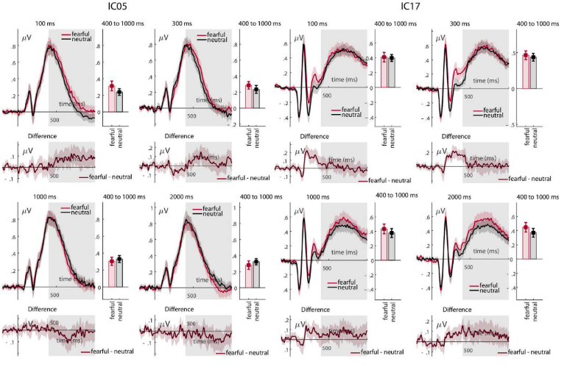
Fig.5

Slide 51
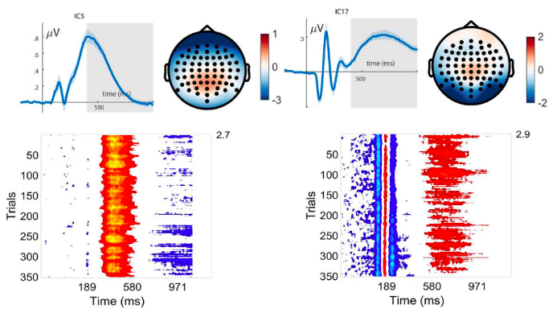
Fig.5

Slide 52
IC 5
A remarkably stable positivity over trials from approximately 300 to 600 msec
No main effect of emotion (p = .450)
The interaction of emotion and presentation duration (p = .015)
Post-hoc comparisons:
A larger positivity for fearful faces for the 100 msec presentation duration condition (t = 2.16, p = .036, Cohen's d = .326)
Other presentation durations: no emotion effect occurred (ts < 1.50, ps > .140)

Slide 53
IC 17
A more variable positivity from 600 to 900 msec
A main effect of emotion (p = .037): fearful faces showed a higher positivity than neutral faces
The interaction of emotion and presentation duration: insignificant (p = .472)
Post-hoc tests (a similar pattern as observed during the LPP)
No differences: 100\300\1000 msec
2000 msec (t(43) = 2.35, p = .023): an increased positivity for fearful faces

Slide 54
Behavioral results:(table 2)
The accuracy:
A main effect of emotion (p = .857)
An interaction of presentation duration and emotion (p = .098)
Reaction times: ```

Slide 55
Control analyses
Test:
differences between conditions for horizontal or vertical eye-related activity
No significant effects of emotion, duration
No interaction between emotion and duration for all examined time windows for ERPs of interest
(table 3)

Slide 56
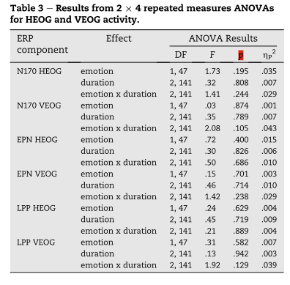
Table 3

Slide 57
4. Discussion
4.1. Investigation
4.2. Theories and studies
4.3. The post-hoc comparisons
4.4. Explain the outcomes
4.5. Explain the insignificant interaction effects
4.6. Increased N170 for emotional facial expressions independent of distracting tasks
4.7. Limitations
4.8. Summary

Slide 58
4.1. Investigation
The influence of the presentation duration on emotional differences during a perceptual distraction task
Expected:
An influence of the presentation duration on EPN and LPP differences
Longer exposure time would lead to larger fearful-neutral differentiation
Registered analyses:
Main effects of emotion for the EPN and LPP components
No significant interaction between duration and emotion

Slide 59
4.2. Theories and studies
Emotional processing is automatic and independent of available processing resources.
Previous studies:
Emotional modulation of mid-latency (EPN) and late (LPP) ERPs even when attention was directed to a different perceptual or working memory task
Our studies:
In contrast to our expectations based on recent findings
Between 50 and 100 msec: an absence of emotional modulations of the EPN and LPP components under distraction with presentation durations varying

Slide 60
These contrary findings:
Explaining the absence or presence of emotion effects under distraction:
Presentation duration to be a relevant factor

Slide 61
The logical relationship：
Since emotional stimuli are known to modulate attention
Expected:
An interaction of emotion and presentation duration in the EPN and the LPP
Leading to enhanced amplitudes for fearful faces
Only when presentation duration was extended to 1,000 msec and 2,000 msec
Allowing participants to process emotional information while completing the perceptual task

Slide 62
4.3. The post-hoc comparisons
Exploratory post-hoc comparisons for each presentation duration separately
Shorter durations: no significant differences between fearful faces and neutral faces were observed
(100, 300, and 1000 msec for the EPN; 100 and 300 msec for the LPP)
Long stimulus intervals: significant differences were seen
To hypothesis:
Shorter presentation times lead to a lower probability of significant emotion effects

Slide 63
4.4. Explain the outcomes
Lower perception and inhibition of distracting information
Longer presentation durations enhance the ability to perceive irrelevant information
Lead to a collapse of inhibitory processes
The relative frontal positivity:
In the 1,000 msec duration condition: (unsuccessful) inhibitory attempts
While this is less pronounced in the 2,000 msec condition
Does not lead to a significant interaction

Slide 64
Thus: (rethinking)
Our sample size and the within-subject design might be unsuited to reveal statistically relevant interactions between presentation duration and emotion effects.
Future studies：
Test this assumption and confirm whether differences between duration conditions remain insignificant and if absent and present effects depend on duration conditions.
Further investigate differences between analytic strategies

Slide 65
4.5. Explain the insignificant interaction effects
Some design changes from the initial pilot data
Such as:
Eye-tracking gaze control
```

Slide 66
4.5.1. Eye-tracking gaze control:
Gaze deviations
Stop the experiment and recalibration procedures (longer testing times)
Rejected (a rather high trial rejection rate and fewer trial numbers)
Prevent differences in gaze behavior
Particularly when faces were presented for longer durations
Control analyses: horizontal and vertical EOG activity (no different)
Slight differences in exploration behavior between conditions during the longer presentation durations might have led to bigger differences in our pilot sample.
Only a few studies that examine emotional face processing report measures of participants' gaze behavior and/or try to control or prevent differences between conditions.

Slide 67
4.5.2. Different late positivities (separated by a group ICA)
An earlier IC (IC 5)
Relate to a parietal P3
Index the detection and response to the target face
An advantage in detecting and/or processing fearful expressions during short stimulus exposure
(100ms)
Did not transfer into a reaction time advantage for these faces
(table 2)

Slide 68
IC 17
The late positive potential relation to controlled attentional processes and stimulus evaluation
Particularly when the appraisal of affective meaning is involved
The higher variability of IC 17 compared to IC 5:
Reflect trial-by-trial differences in the activation of
Occipito-parietal regions, subcortical areas, and fronto-parietal attention networks,
Which are suggested to contribute to LPP effects

Slide 69
Similar to the main LPP findings, for IC 17:
Fearful-neutral differences increased descriptively with increasing presentation duration
Separate t-tests per duration conditions:
A similar pattern of absent differences during the presentation durations:
No differences: 100\300\1000 msec
2000 msec (t(43) = 2.35, p = .023): an increased positivity for fearful faces

Slide 70
4.6 Increased N170 for emotional facial expressions independent of distracting tasks
A meta-analysis:
Emotional modulation of the N170 reflect:
Highly automatic encoding of emotional expressions
Increased N170:
Due to perceptual differences between emotional and neutral facial expressions
Neutral faces associated with negative information: increased N170
N170: at least some emotional association is processed

Slide 71
4.7. Limitations
Control for task difficulty:
A task that could be solved easily
Only one
Greater task difficulty?
Task-relevant and irrelevant information was presented simultaneously at the same location:
Differences in the face-distractor temporal or spatial onset relative to the task-relevant stimuli might lead to smaller or absent EPN or LPP effects.
Repetition effects were reduced but could not be fully excluded:
each face was presented four times in the experiment
counterbalanced the order of presentation duration

Slide 72
4.8. Summary
The duration of the presented face stimulus is not a major factor explaining the variability of reported emotion effects in perceptual distraction tasks
At least for the given experimental and analytical setup and when eye-gaze is strictly controlled

Slide 73
That’s all. Thanks!
Jiang

